Slide 1
Video Game Playtime and stats analysis
Rayan Arshed
Xander c13

Slide 2
Goal of analysis?

Slide 3
To investigate video game statistics to help inform you about current trends in the market and make data-driven decisions for the future.

Slide 4
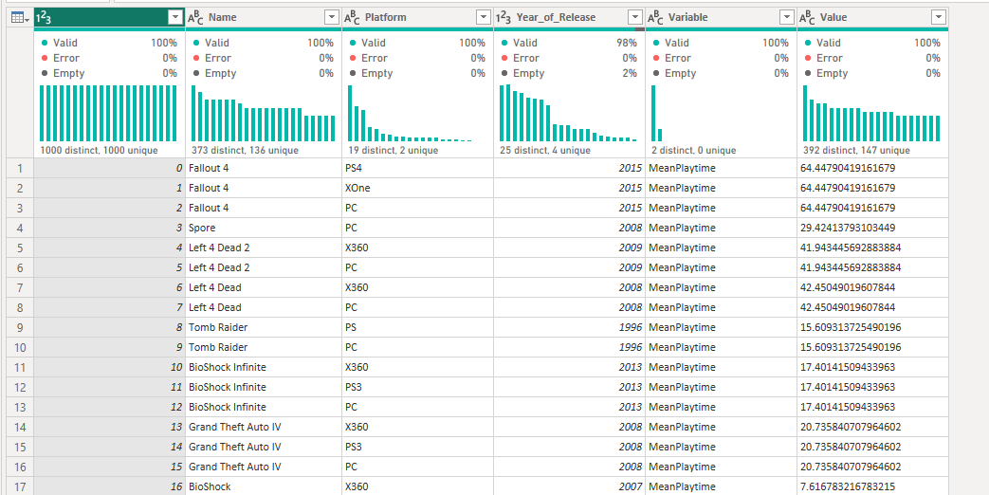
Dataset source
Source: https://www.kaggle.com/datasets/alex333/video-games-with-reviews-and-playtime-statistics
Data arrived in this format:
Not ideal…

Slide 5
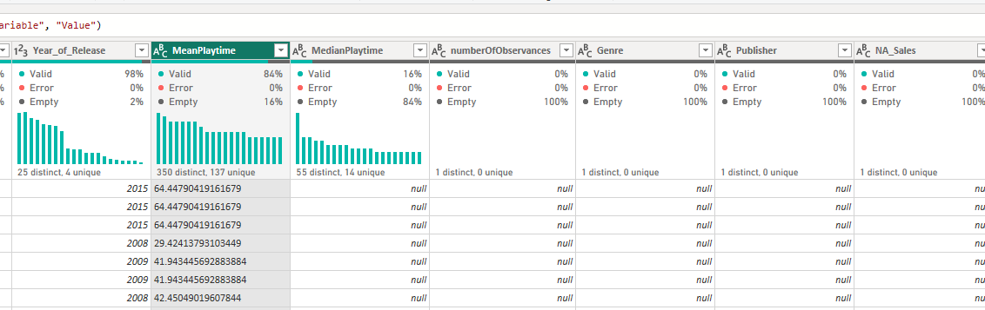
But with the power of Dax…
I was able to convert the dataset into a fully formed table by using the Pivot command

Slide 6
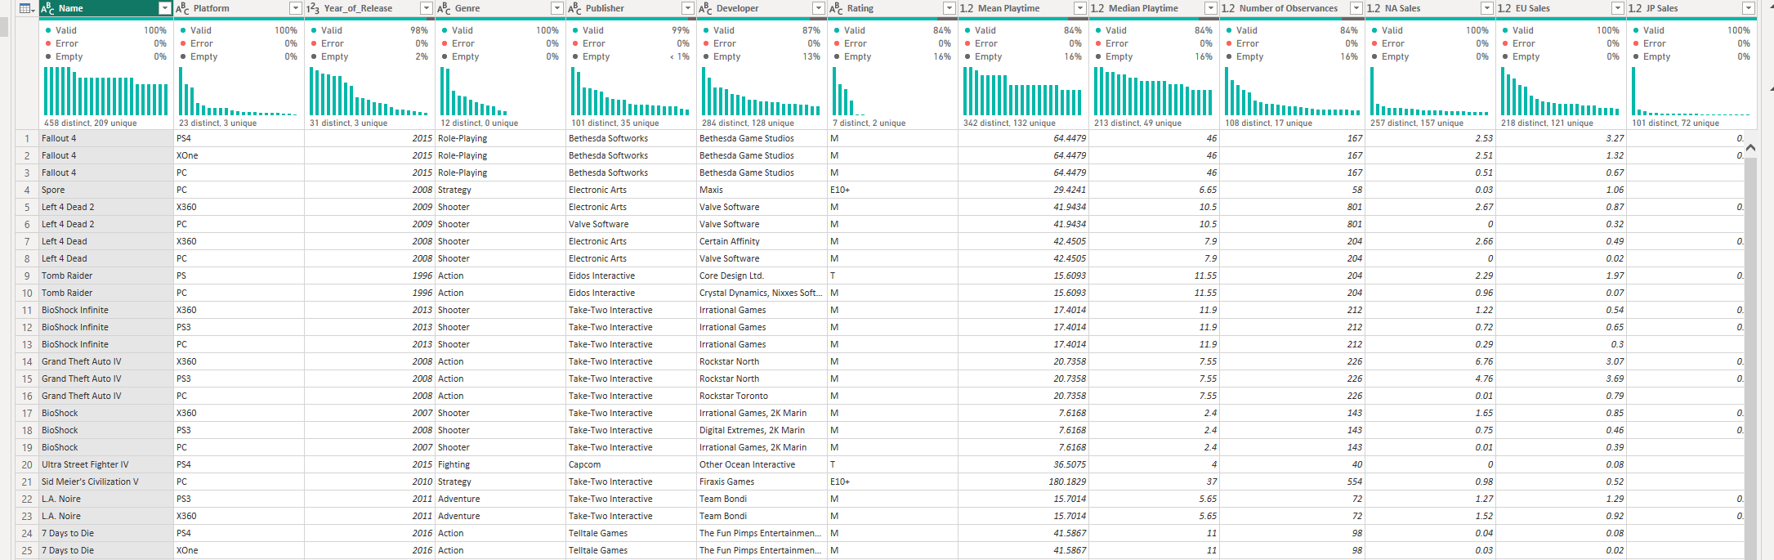
After some aggregations…
I was able to clean the dataset to remove redundant null values, so each row was specific to a game and the platform it was released on

Slide 7
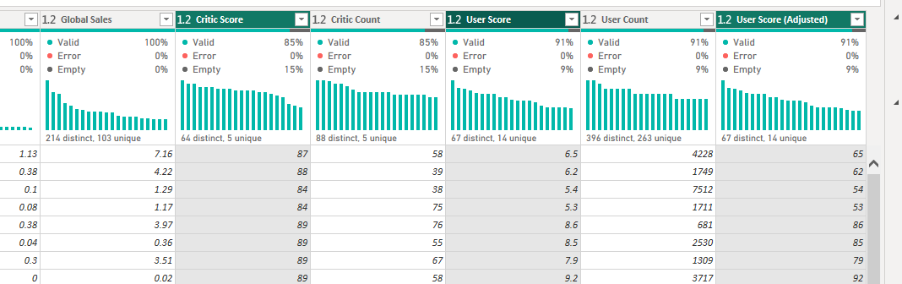
Finally, with some filtering and transforming…
I was able to remove null values specifically for playtime, corrected datatypes for different columns, and created an additional column to make future comparisons easier

Slide 8
Now the analysis can begin!

Slide 9
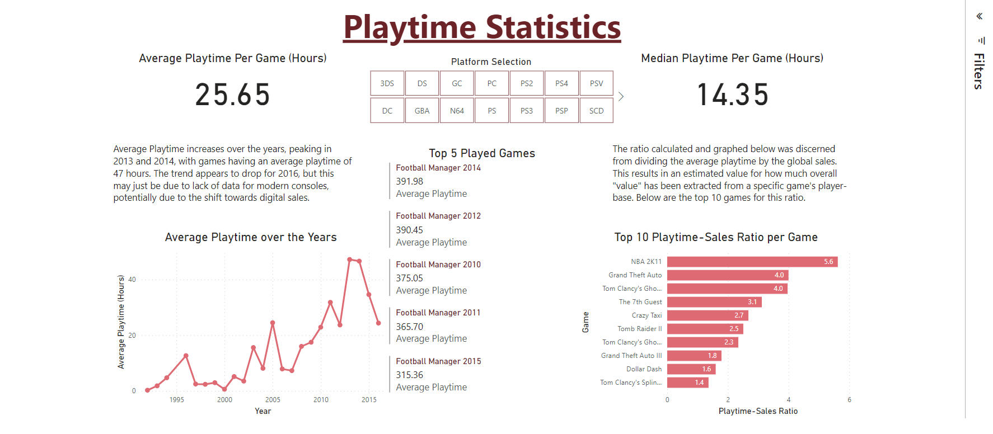
Firstly, I broke down the dataset into key variables
This resulted in 6 different dashboards in my report, each corresponding to different data features. Firstly, playtime statistics were analysed.

Slide 10
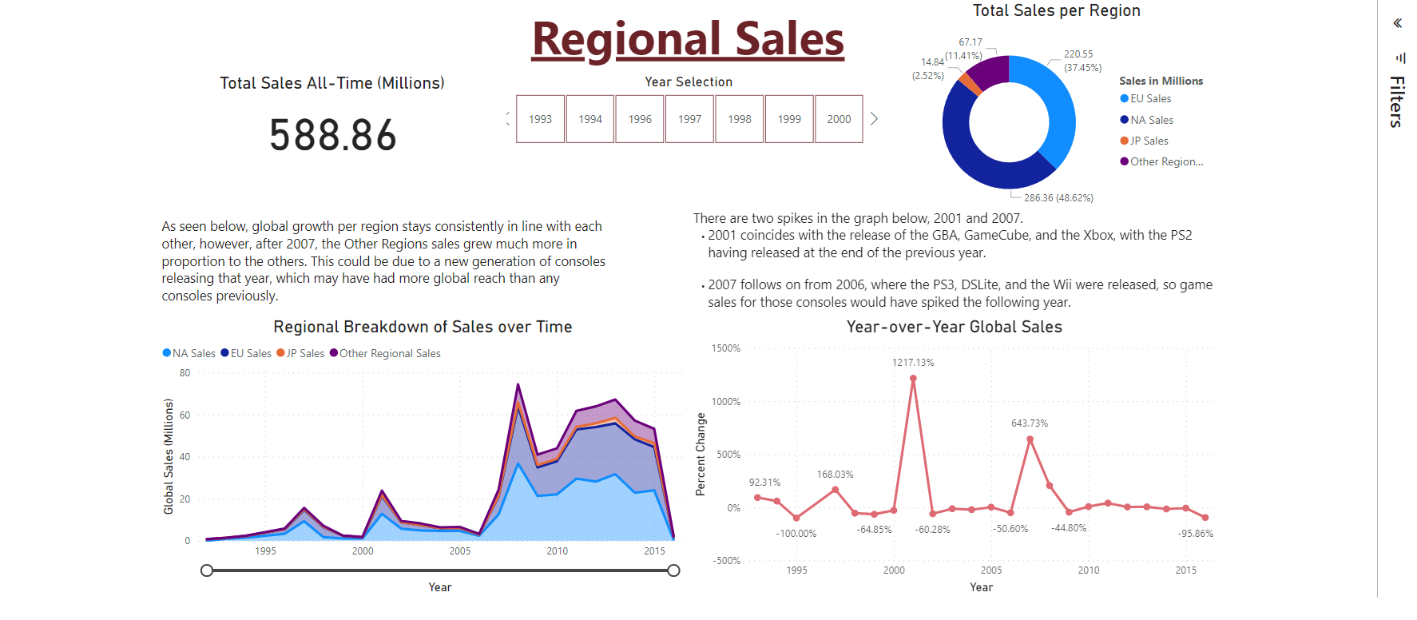
Next, regional sales

Slide 11
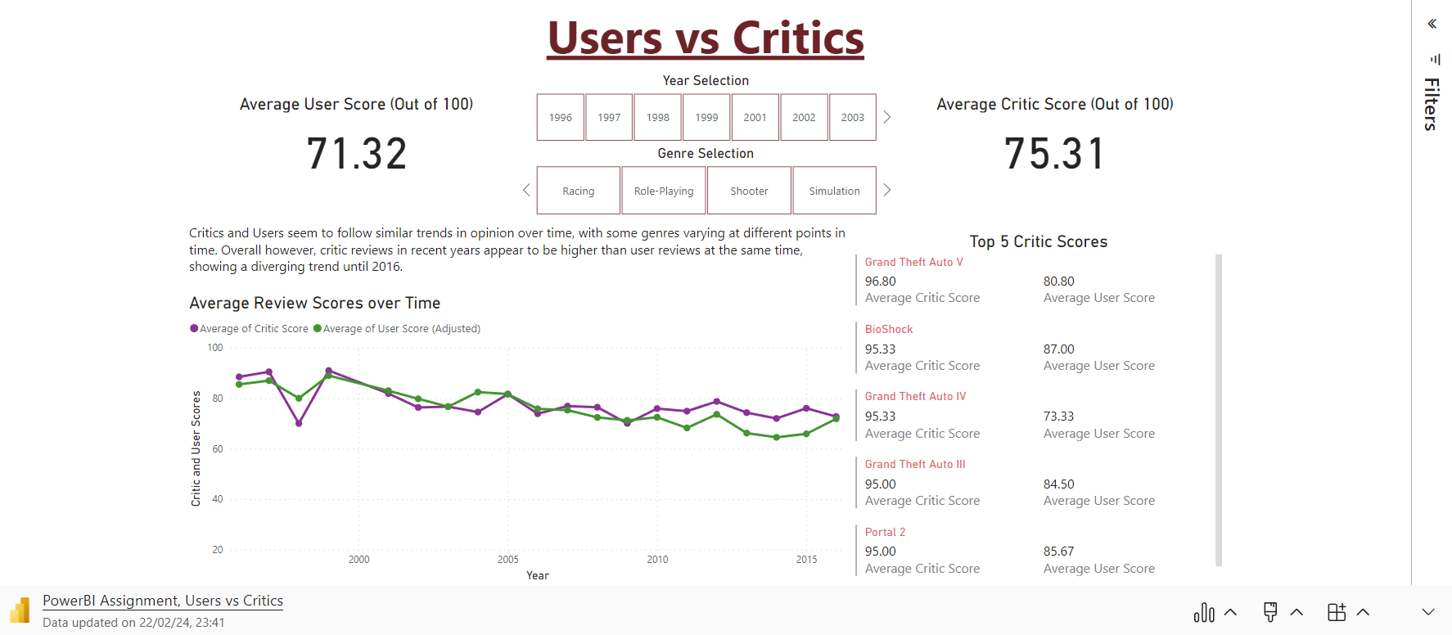
Then, Users vs critics

Slide 12
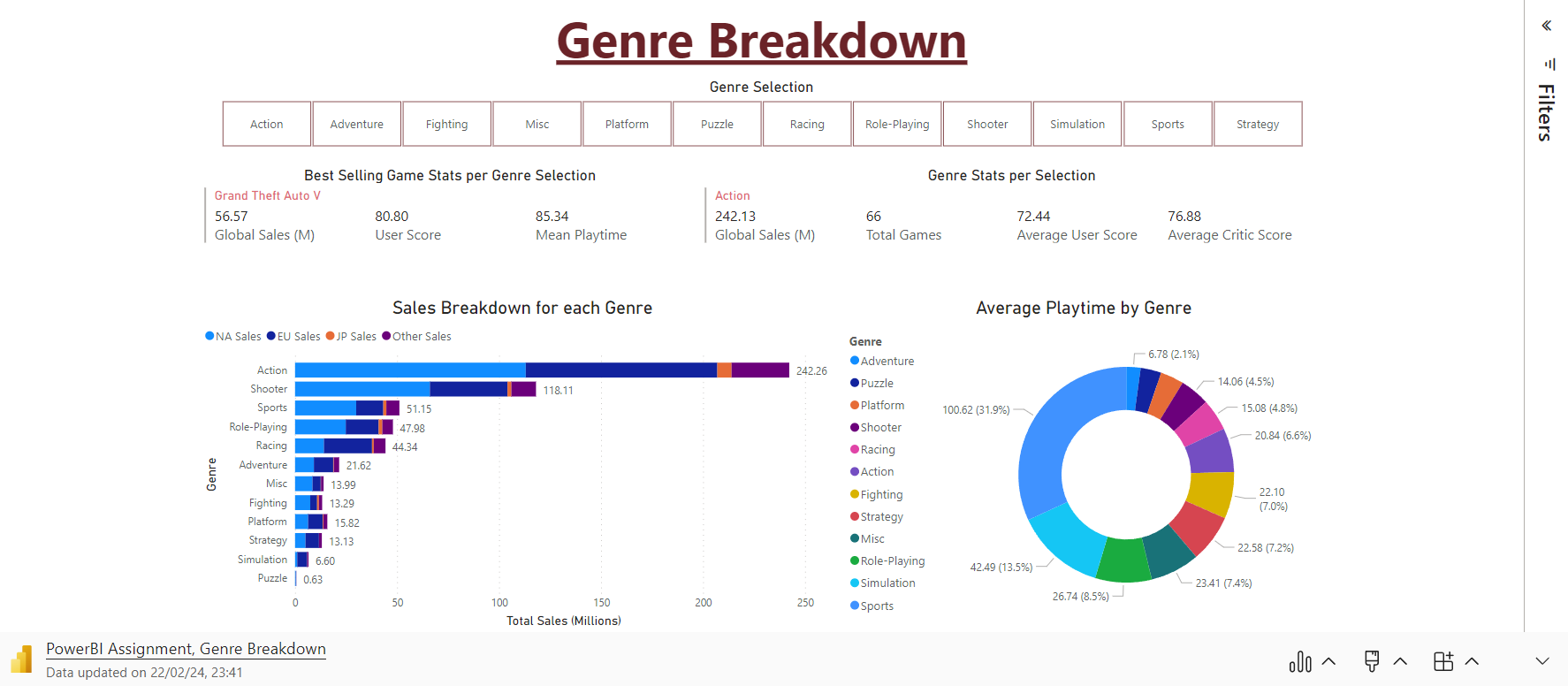
Following that, genre breakdown
I created 4 different breakdowns to allow users to drill down through the data to check features of specific data values

Slide 13
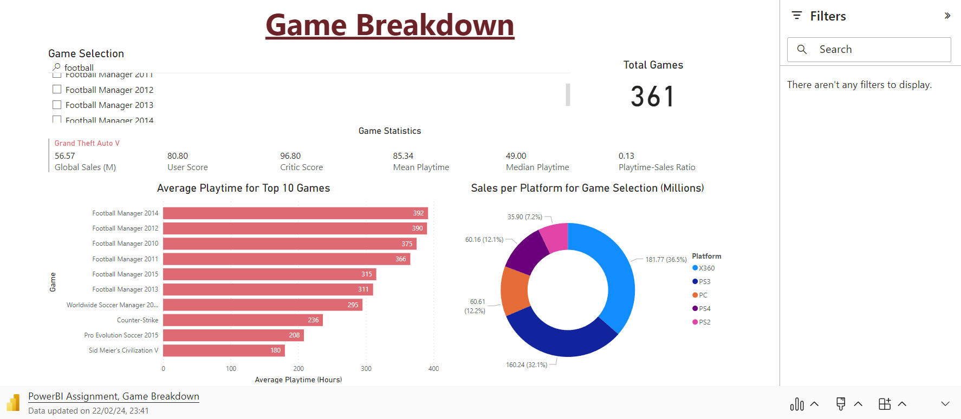
Game Breakdown…

Slide 14
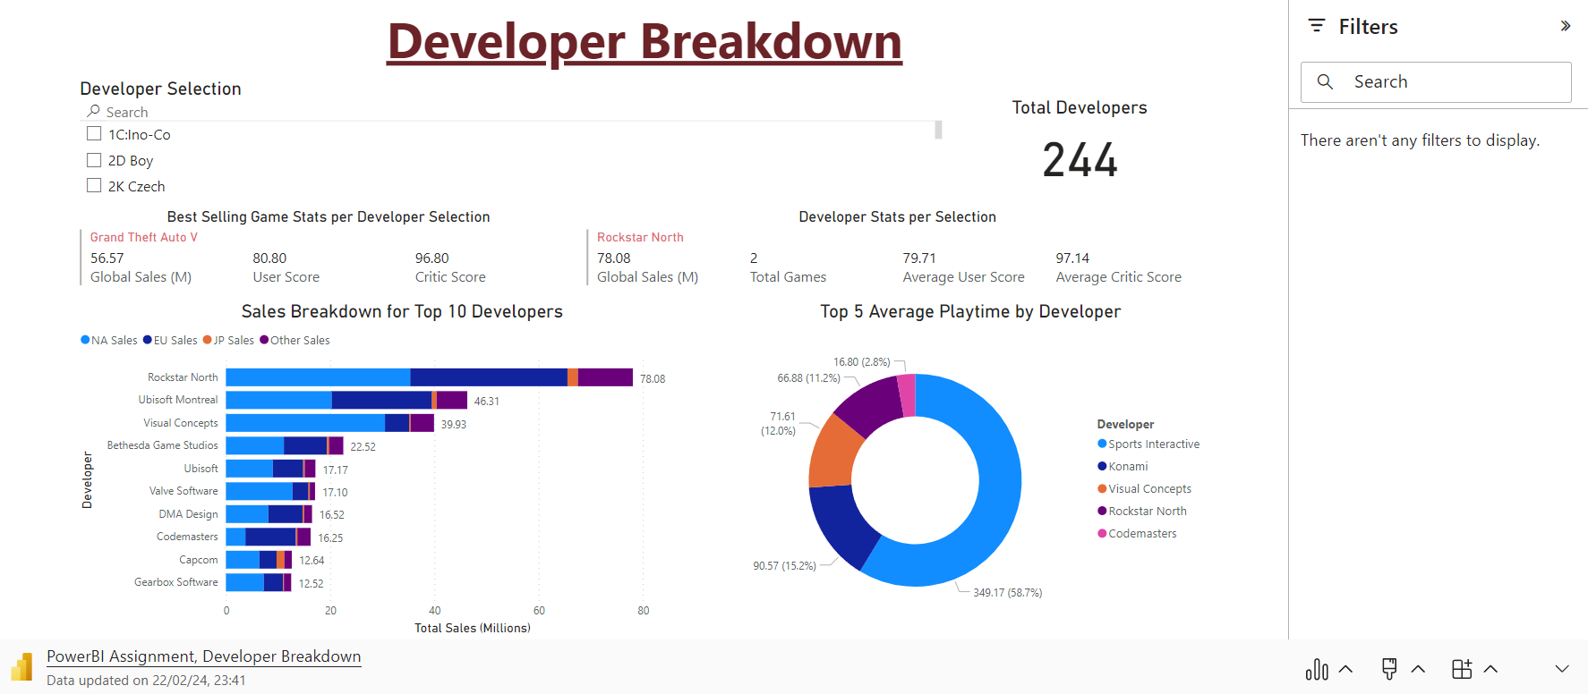
Developer Breakdown

Slide 15
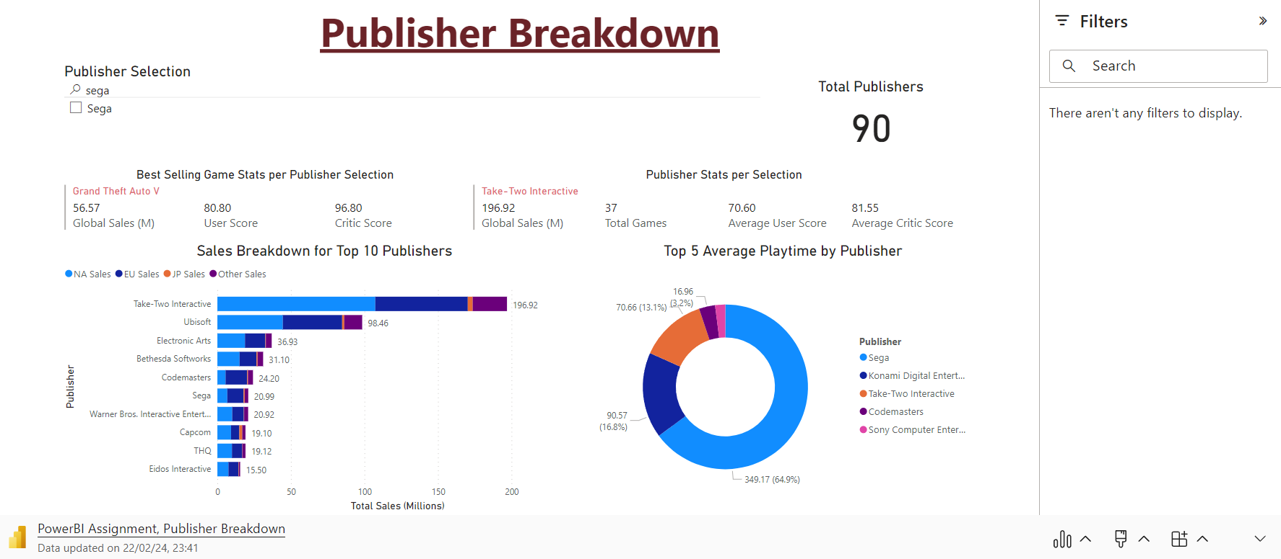
Publisher Breakdown

Slide 16
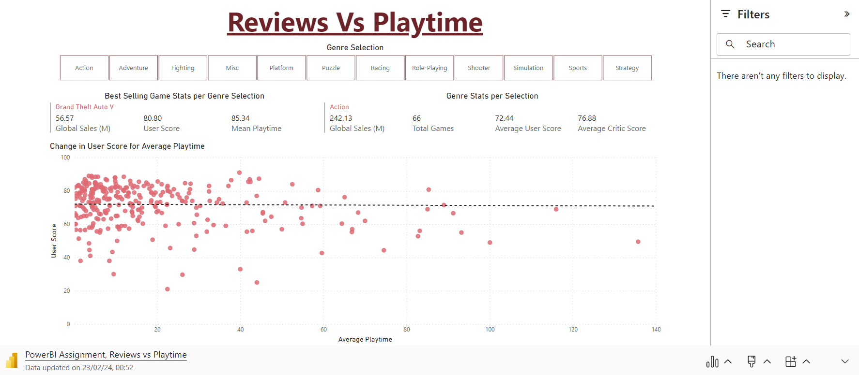
Finally, User Scores Vs Playtime
Finally, I compared these two variables to determine their effect on each other, and the trends for each genre.

Slide 17
In conclusion?

Slide 18
Conclusion
Average Playtime for games overall has increased over the years
The Average Playtime for specific Genres has different effects, for example:
For Action and Racing, users prefer a short and sweet experience, which lets them get to the game’s content faster to experience it quicker
For Sports and Shooters, users prefer a well-baked longer game, with deeper systems that allow them to experience everything the game has to offer, and willingly participate in lengthier or repetitive gameplay loops
Global Sales outreach spike on each new console generation, and regional reach is greater than ever before
Therefore, the best time window to release a long-experience game would be at the start of a console generation, so plan to develop these games for those release windows.
The best time to release a short-experience game would be to do so closer to the end of a console’s lifecycle. This way, you can take advantage of modern tech improvements and breakthroughs, to provide an innovative experience to users

Slide 19

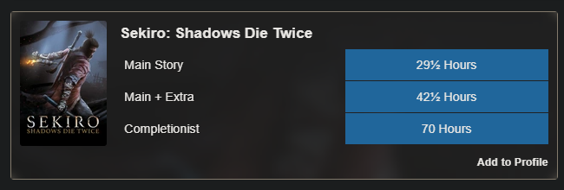
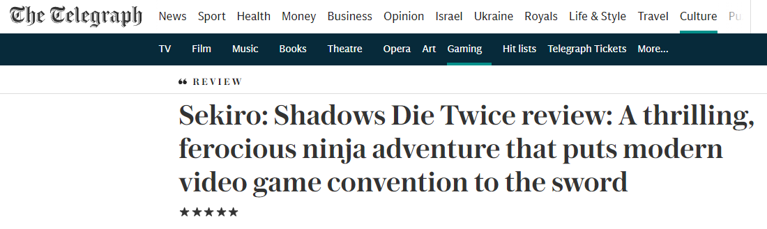
Example of a short, innovative, Modern action game
Released in the latter half of the previous console generation, brought many new innovative gameplay features and experiences to the table, with a very fun and interactive gameplay loop, and was a huge success thanks to this
https://howlongtobeat.com/game/57415
https://www.telegraph.co.uk/gaming/features/sekiro-shadows-die-twice-review-thrilling-ferocious-ninja-adventure/#:~:text=This%20melancholy%20and%20brutally%20hostile,down%20an%20almost%20belligerent%20challenge.

Slide 20

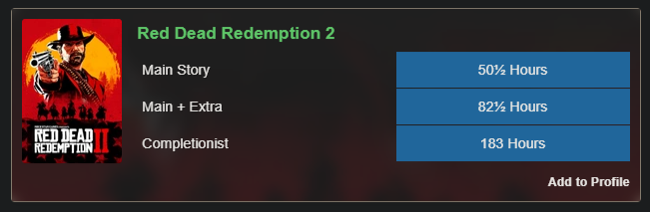
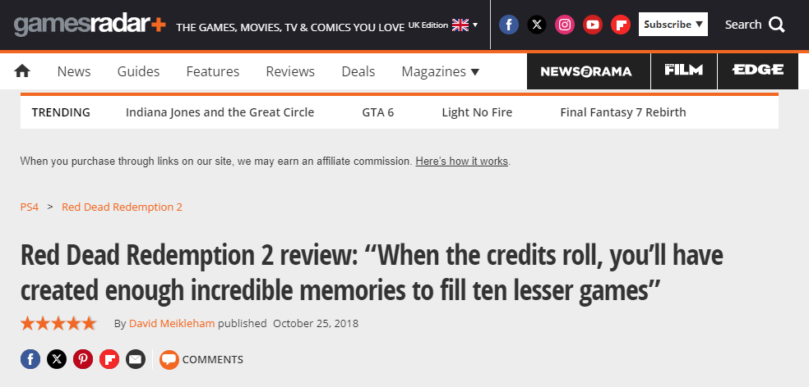
Example of a Long, well-baked, developed shooter
Released right at the end of the previous console generation, while providing forward compatibility for modern consoles, this game took advantage of modern innovations, and created a critically acclaimed story to match their intricate gameplay systems that enhance the players’ experiences
https://howlongtobeat.com/game/27100
https://www.gamesradar.com/red-dead-redemption-2-review/#:~:text=GamesRadar%2B%20Verdict,all%2Dtime%20Old%20West%20masterpiece.

Slide 21
Thank you for listening!
Any questions?

